Slide 1
DATA VISUALIZATION ASSOCIATE EARLY REMOTE INTERNSHIP
Final Presentation & Program Closure Submission
Opportunity & Learner Engagement
From unstructured data to a validated, dashboard-ready dataset of 14,825 applications
DVA TEAM 15 (Grace Onwuasoanya & Idowu Oluwaseun)
Data Visualization Associate Interns | Excelerate | Week 4

Slide 2
Project Overview
Four weeks, one connected story: from raw data to a working dashboard
1
2
3
4
Setup & Exploration
Integration & Cleaning
Dashboard & Analysis
Findings & Recommendations
Connected PostgreSQL on Aiven and explored two raw datasets: Opportunity Data and Learner Data.
Found the real join key linking learners to opportunities, then cleaned and validated the combined dataset.
Built a Looker Studio dashboard covering sign-ups, completion, rewards, scholarships, and trends.
Turned the validated data into findings and specific, data-backed recommendations.
This presentation is the Week 4 final report. It covers the finalized datasets, the analytical approach, the dashboard's key visuals, the findings they reveal, and what Excelerate should do next.
2

Slide 3
Dataset Overview
Two source datasets, joined into one validated table (integrated_dataset)
Opportunity Data
Learner Data
5,733 raw records 5,730 after cleaning
15,029 raw records 14,825 after cleaning
Internships, careers, competitions, courses, events, and more. Removed 3 corrupted records.
Every learner application, its status, dates, and payment details. Removed 204 corrupted or duplicate rows.
sk → opportunity_id
98.47%
100%
14,825
Join key confirmed
Raw match rate
Category agreement check
Rows in integrated_dataset
3

Slide 4
Analytical Approach
How the raw datasets became one joined dataset
1
2
3
4
Find the key
Clean first
Fill what's fixable
Validate everything
Tested three fields. sk to opportunity_id was the only real match, at 98.47%.
→
Removed corrupted and duplicate rows, then nulled applications linked to fake opportunities.
→
Backfilled category and fee from the join, recovering 9,000+ rows that were missing both.
→
Every dashboard number is backed by a matching SQL query, checked before publishing.
Full methodology, including every SQL statement and the numbers behind each cleaning step, is documented in the Week 2 Data Cleaning & Validation Report.
4

Slide 5
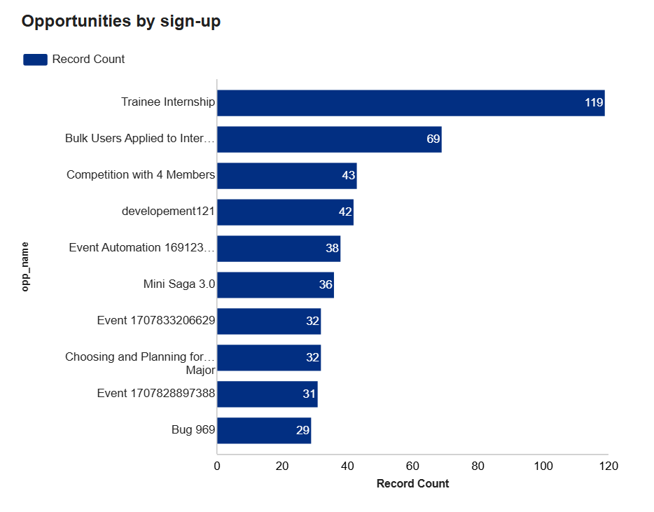
Opportunity Sign-Up Performance
Which opportunities pull in the most applications
2
What this shows
Trainee Internship received the highest number of applications (119), nearly double that of the next opportunity. This indicates that learner interest was concentrated in a few opportunities, with Trainee Internship attracting the highest demand.
2
5

Slide 6
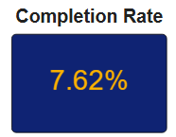
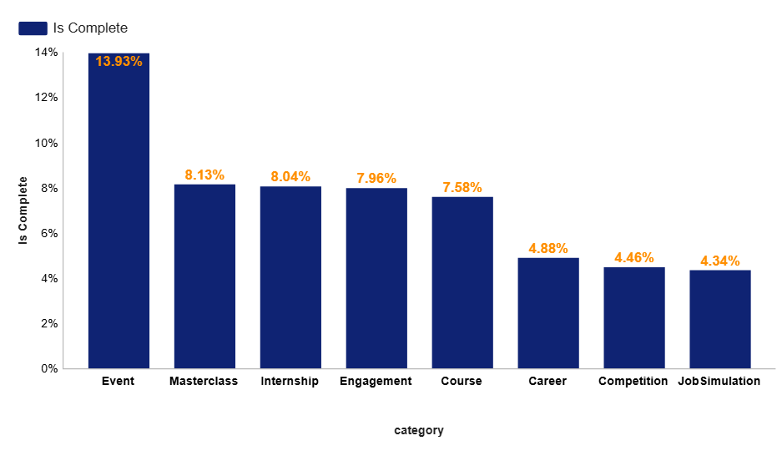
Completion Rates Across Opportunities
How far applications actually get, by category
What this shows
The overall completion rate across all applications is 7.62%, which is relatively low.
Event recorded the highest completion rate at 13.93%, while Career, Competition, and Job Simulation were all below 5%. This indicates that most applications do not progress to completion, regardless of category.
6

Slide 7
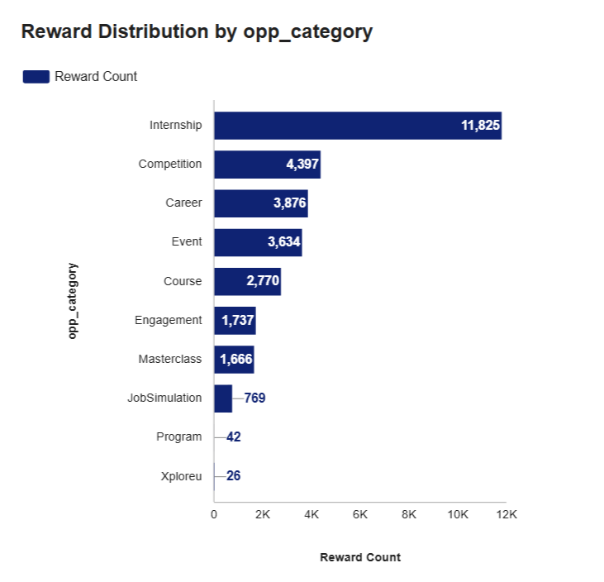
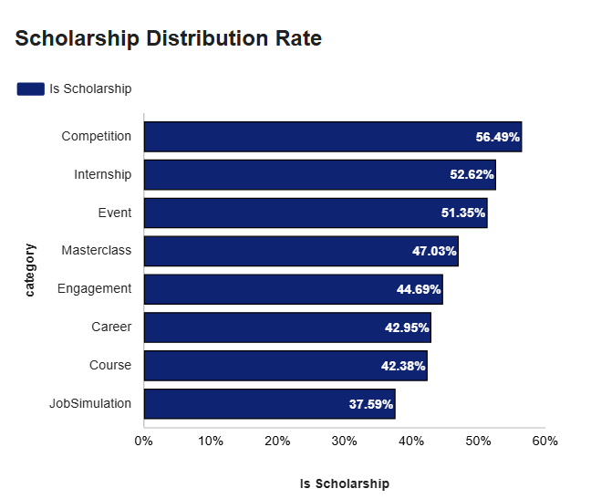
Rewards & Scholarships by Category
How rewards and scholarship coverage break down
Internship offered the highest number of rewards, reflecting their high application volume. Competition recorded the highest scholarship rate at 56.5%, while every other category maintains scholarship coverage above one-third.
7

Slide 8
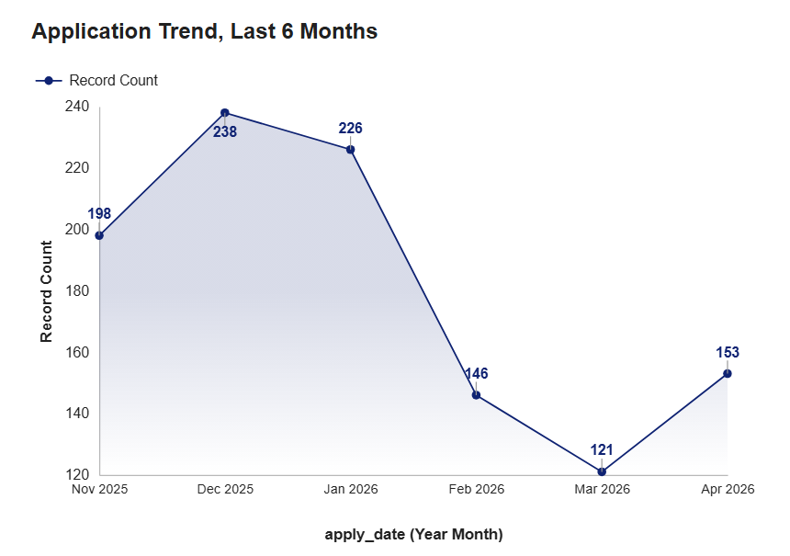
Application Trends Over Time
Six-month trend, and how the last two quarters compare
2025 Q4 vs 2026 Q1
720
493
2025 Q4
2026 Q1
↓ 31.5%
drop in applications, Q4 to Q1
Applications peaked in December 2025 with 238 applications. Since then, monthly applications have generally declined, with only a slight recovery in April.
8

Slide 9
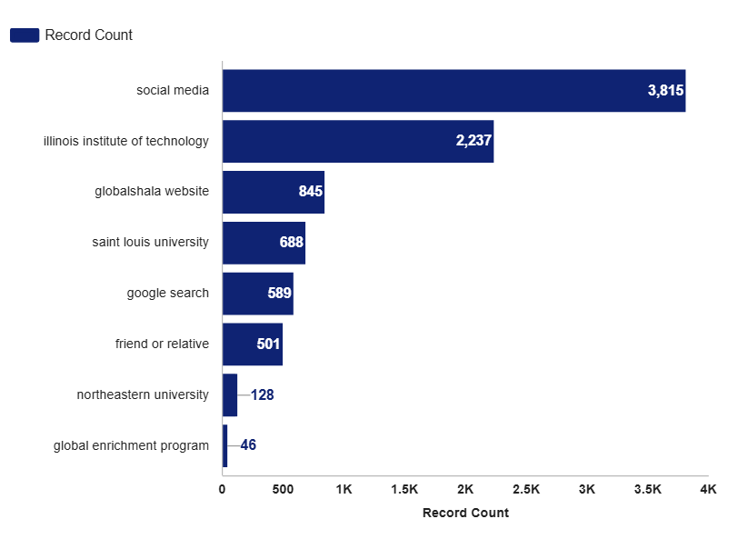
Lead Source Performance
Where applications actually come from
What this shows
Social Media brings in 42.8% of all applications with a known source.
Together, Social Media and Illinois Institute of Technology account for more than two out of every three applications. The remaining lead sources each contributed a much smaller share of applications.
9

Slide 10



Key Findings
What the validated data actually tells us
Demand is concentrated
Completion is low across categories
A small number of opportunities, led by Trainee Internship at 119 sign-ups, account for a disproportionate share of applications.
Overall completion is 7.6%. Even the strongest category, Event, only reaches 13.9%. Career and Competition sit under 5%.
Two sources drive most activity
Applications are declining
Social Media and Illinois Institute of Technology together bring in more than two thirds of all applications with a known source.
Applications peaked in December 2025 before declining across most subsequent months. Q1 2026 recorded 31.5% fewer applications than Q4 2025.
10

Slide 11
Recommendations
1
Investigate why Career and Competition have such low completion rates compared to Event by engaging learners who did not finish to find out where and why they dropped off.
Conclusion
Investigate the decline in applications since December 2025 to determine whether it is driven by seasonality, marketing changes, or platform-related issues.
Over four weeks, two messy disconnected datasets were transformed into a validated, dashboard-ready dataset that supports reliable analysis and decision-making. Every result presented is supported by validated SQL queries rather than assumptions.
2
3
Reduce reliance on two major lead sources by expanding outreach to additional partner institutions marketing platforms. Social Media and Illinois Institute of Technology drive most activity today.
Live dashboard link:
4
Introduce mid-process follow-ups for high-volume opportunities such as Trainee Internship to improve application completion rates.
Looker Studio Dashboard
SQL validation queries (appendix):
Monitor completion rates by category on a regular basis to evaluate whether improvement initiatives are producing results.
SQL Queries
5
Recorded team presentation:
Team Presentation Video
Thank you.
DVA TEAM 15 | Data Visualization Associate Interns | Excelerate
10

